Slide 1
CISC108
Introduction to Computer Science
[Professor Name]
University of Delaware
Week 11 - Final Project

Slide 2
Final Project!
Working with Canvas data using a library.
Courses
Submissions
To make a program to access Canvas data from the console!
Similar to Lecture 10’s assignment.
from bakery_canvas import get_courses
courses = get_courses("annie")
for course in courses:
print(course)

Slide 3




Web Request Difficulties
Slow Speed
No Wifi
Website changes
Non-deterministic
Limited by data transfer rates
Sometimes internet goes down
Request endpoint is not under your control
Data updates rapidly, hard to test consistently
Notes:
Just a quick slide to remind them of the difficulties of web data. Spend less than a minute here! Don’t go into detail!

Slide 4
Solution: “Caching”
Cache
Requests-cache
Remember previously returned results for later reuse!
Popular library that seamlessly sits on top of Requests to “cache” requests.
Notes:
And not much time spent here either, just remind them that caching is a thing…

Slide 5
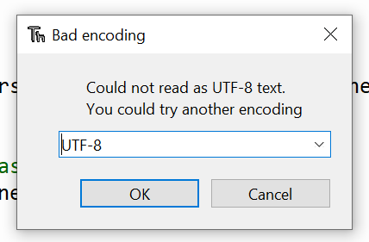
bakery_canvas_cache.sqlite
A file provided by the instructor for the bakery_canvas.py library.
Do not open directly!
If you see this, you tried to open the “binary” sqlite file!
Notes:
Mention that there’s a second file they need to download and put in their work folder (the instructions in the assignment tell them how to do this). They should NOT open this file directly in Thonny or any other application.

Slide 6
File types
"Text" files
"Binary" files
All files are just a bunch of numbers
The numbers can all be interpreted as characters
The numbers make no sense as characters
Notes:
Python files are text files. The sqlite file is a binary file that is meant for computers, and not humans.

Slide 7
Parts + Milestones
3 Parts: All must be completed by end of project!
2 Milestones: Correspond to first 2 parts, 10% of project, strict deadline.
Notes:
Okay now the critical part. Students need to know that there are two MILESTONE submissions that are each worth 10% of the course grade.
This is distinct from the three PARTS to the assignment. The first two milestones correspond to the first two parts of the project, and they are each worth 10% of the project grade. The goal is to motivate them to work regularly!

Slide 8
If you miss both milestones (ie try to wait till December to start final project) then you automatically lost 20% of the project grade!
“You cannot pass the course if you fail the final project”!
-Syllabus
Notes:
This slide spells it out. The milestones keep them on track for completing the project. If you skip both milestones, then the best you can do on the project is an 80%! And they need to get at least a 70% to pass the class.

Slide 9
Final Project Timeline
Part 1 + Milestone 1 (20%) + (10%)
Part 2 + Milestone 2 (20%) + (10%)
Part 3 + Code Review (25%) + (15%)
Due Friday Nov 18
Part 1 stays open, Milestone locks.
Due Friday Dec 2
Part 2 stays open, Milestone locks.
Due Sunday Dec 11
All parts lock.
Grade for milestone is put in automatically, you do not submit anything.
Notes:
And this slide breaks down the timeline. Exact percentages are subject to change.

Slide 10
What remains?
Final project, its milestones, and its code review
One more week of textbook work (short)
Final Lecture
Final Exam
Survey 4
...?

Slide 11
Rest of Today
Work on Final Project
Make sure you finish Milestone 1 by next week
Part 2 should open within the next 36 hours.
We are here to help!

Slide 12
CISC106
Have a great day!
See ya!

